Slide 1
Full Stack Components
II - II
22H51A0595

Slide 2
Table of contents
01
02
03
04
Introduction to Full Stack Development
Front End
[Client Side]
What is Full Stack Development?
HTML…Frameworks
Back End
[Server Side]
Other
Web Servers, Databases…
Version Control, APIs, Security

Slide 3
01
Intro to Full Stack Development

Slide 4
Introduction
Full Stack Development is a term used to describe developers who have a strong understanding and expertise in both the front-end and back-end of web development.
Full stack developers possess a well-rounded skill set that allows them to work on all aspects of a web application, from the visual design to the underlying infrastructure. This versatility is highly valued in the tech industry.
Front-end development deals with the client-side of a web application, which is the part that users interact with directly.
Back-end development focuses on the server-side of a web application, which handles the logic, data storage, and communication with the front-end.

Slide 5
02
Front End [Client Side]

Slide 6
Front-end development is the process of creating the visual elements of a website or web application that users interact with. It involves designing and building the user interface (UI) that determines how a website looks and functions.
HTML (Hypertext Markup Language): The fundamental building block of web pages, defining the structure and content of a website.
CSS (Cascading Style Sheets): Used to style HTML elements, controlling their appearance, layout, and formatting.
JavaScript: A programming language that adds interactivity and dynamic elements to web pages, handling user interactions, animations, and data manipulation.
Front-End Frameworks/Libraries:
React.js: A library for building user interfaces, especially single-page applications.
Angular: A platform and framework for building single-page client applications using HTML and TypeScript.
Vue.js: A progressive framework for building user interfaces, easily integrated into projects with other libraries or existing projects.
Responsive Design: Ensures the web page looks good on all devices (desktops, tablets, mobile phones).
Version Control Systems: Tools like Git are used to manage and track code changes.

Slide 7
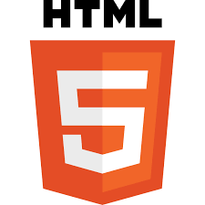
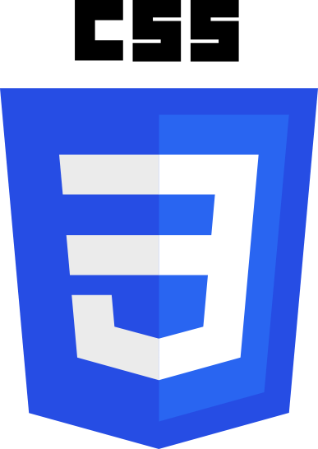
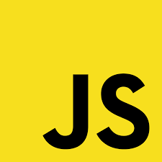
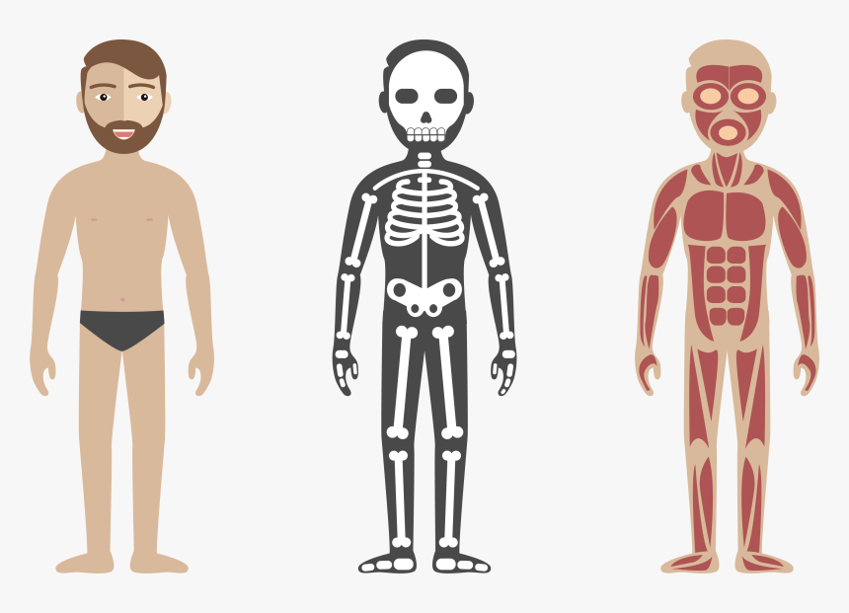
HTML - CSS - JS
Skeleton
Skin
Brain & Muscles

Slide 8

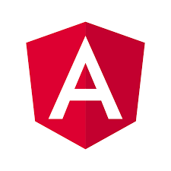
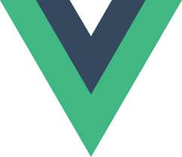
Frameworks
React JS
Angular JS
Vue JS

Slide 9
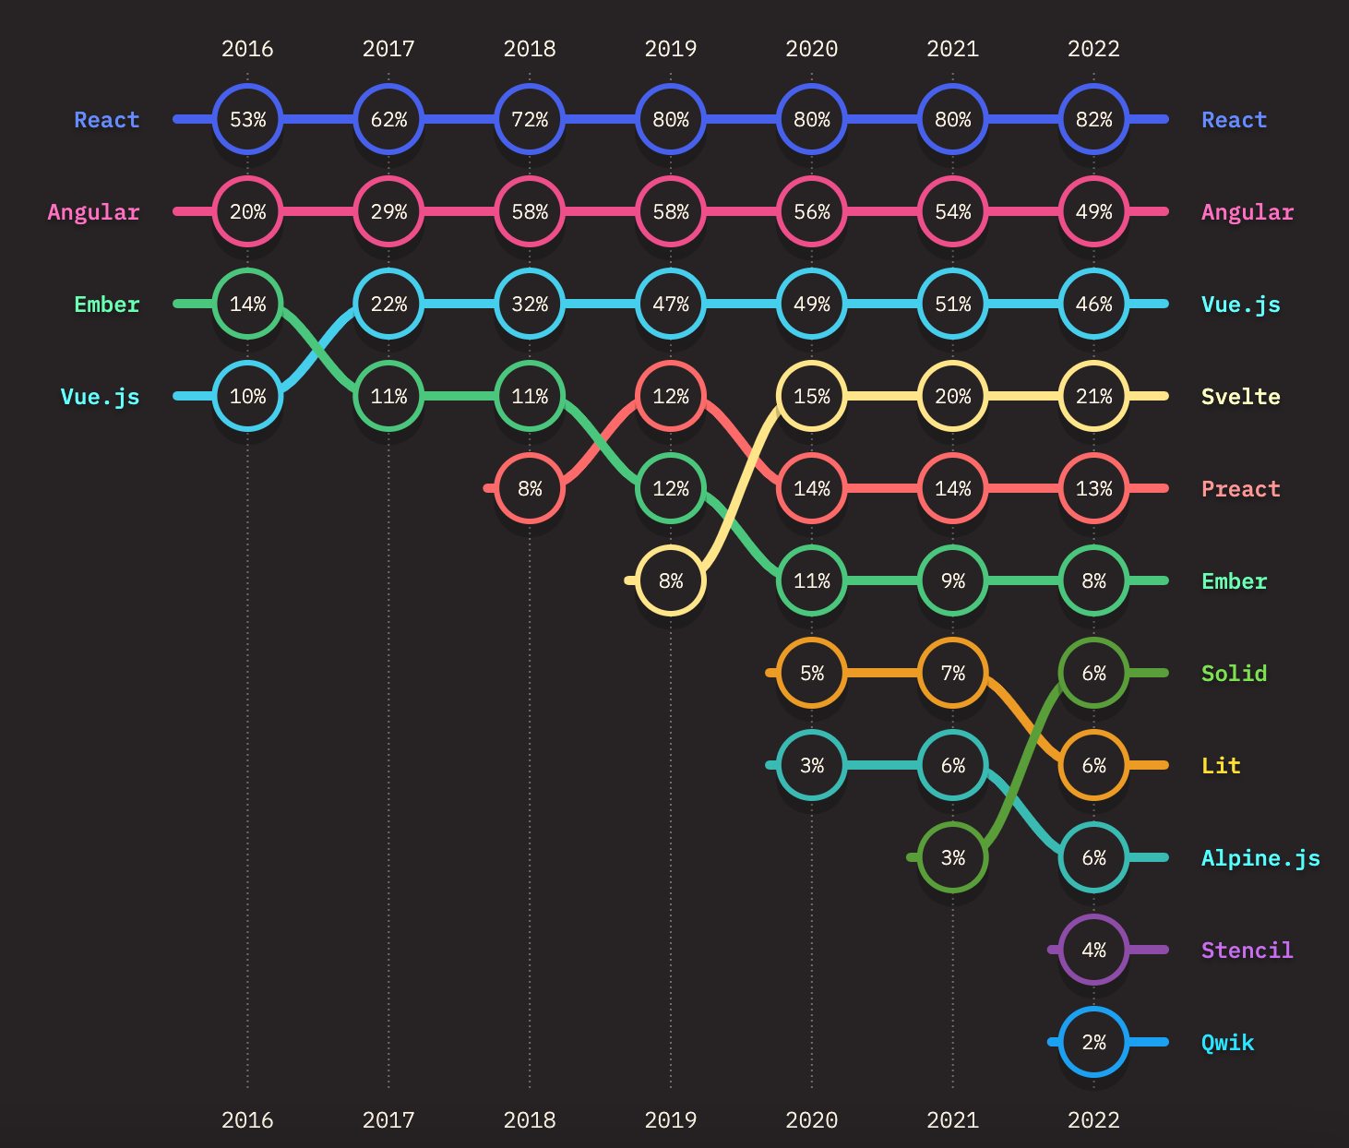
Frameworks > Usage
Over the course of time the number of frameworks increased and their usage in the industry varied depending on their ease of use and developer preference along with product requirements.

Slide 10
03
Back End [Server Side]

Slide 11
Technologies and Concepts Used
Server-Side Programming
Databases
Python, Ruby, Java, Node.js, and PHP are commonly used to write back-end logic.
1
2
MySQL, PostgreSQL, MongoDB, and Oracle are used to store and manage data.
Planar Graphs
Web Frameworks
API Development
Django, Rails, Spring, Express.js, and Laravel provide pre-built components and tools to streamline back-end development.
3
4
Creating Application Programming Interfaces (APIs) that allow different systems to communicate and exchange data.

Slide 12
04
Other

Slide 13
DB & Deployment
DevOps and Deployment
CI/CD (Continuous Integration/Continuous Deployment): Tools like Jenkins, Travis CI, or GitLab CI to automate testing and deployment.
Containerization: Tools like Docker to package applications and dependencies into containers.
Cloud Platforms: AWS, Google Cloud, or Azure for hosting and scaling applications.
Server Management: Managing server configurations and deployment environments.
Database Management
SQL (Structured Query Language): Used to manage and manipulate relational databases.
NoSQL Databases: Handle large volumes of unstructured data.
ORM (Object-Relational Mapping): Tools like Sequelize (for Node.js), Hibernate (for Java), or Django ORM (for Python) help in interacting with databases in an object-oriented way.

Slide 14
VC, API’s & Security
Version Control & Collaboration
Git: A distributed version control system to track changes in source code.
GitHub/GitLab/Bitbucket: Platforms for hosting repositories and collaborating on code.
APIs (Application Programming Interfaces)
RESTful APIs: Use HTTP requests to GET, POST, PUT, DELETE data.
GraphQL: An alternative to REST for querying data more efficiently.
WebSockets: Enables real-time communication between the client and server.
Security
Authentication & Authorization: Implementing user authentication (e.g., OAuth, JWT) and authorization.
Data Encryption: Using SSL/TLS for secure data transmission.
Secure Coding Practices: Preventing vulnerabilities like SQL injection, cross-site scripting (XSS), and cross-site request forgery (CSRF).

Slide 15
THANK YOU

